Slide 1

Simulation and Modeling of Dynamic Systems with Time Varying Device Characteristics
Mansun Chan, Dept. of ECE, HKUST

Slide 2






What are we modeling?
Model template defined by SPICE
M1 1 0 L=1u W=1u
…
.MODEL XMEM (LEVEL=54 VTO=-0.8V KP=16U
… )
Instant parameters for geometry
Passive elements
Sources
Transistors
Transmission lines
Transformers
…
SPICE input deck
Model parameters for physical behavior
$$I_{x}=f_{x}\left(V_{1}\left(t\right),V_{2}\left(t\right),…,V_{n}\left(t\right)\right)$$
$$=f_{x}\left(\tilde{V}\left(t\right) \right)$$

Slide 3
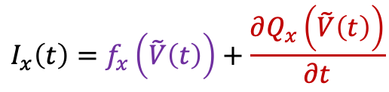
Device behavior
Device equations
$$I_{x}\left(t\right)=f_{x}\left(\tilde{V}\left(t\right)\right)+\frac{∂Q_{x}\left(\tilde{V}\left(t\right)\right)}{∂t}$$
steady state
charging
V₁(t)
Quasi-Static approximation used
Parameter set
V₃(t)
V₄(t)
V_{T}=0.7, C_{ox}=xxx, W=xxx, L=xxx
V₂(t)
Constant node voltages
constant currents
V(t)
I
constant
constant
After reaching steady state
t
t

Slide 4
What are we missing?
Some device are time varying even with constant node voltages such as memory and oscillators
Some systems may drift with time, such as circuit reliability and aging simulation
Self-evolving system such as neuromorphic computing
Constant node voltages
V(t)
constant
t
Device characteristics
I
conventional
After reaching steady state
dynamic
t

Slide 5
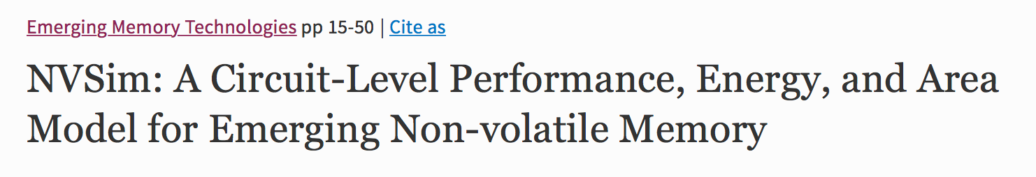
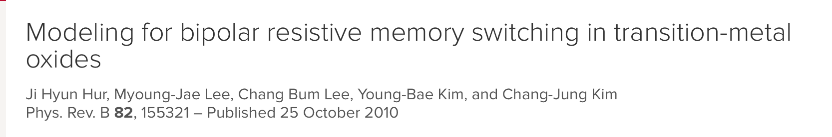
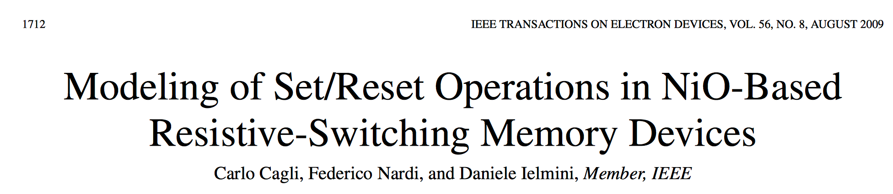
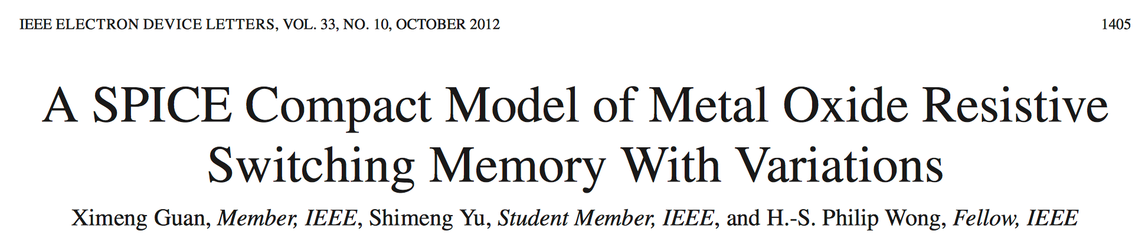
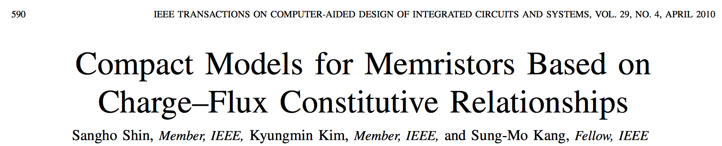
Many memory modeling papers published

Slide 6
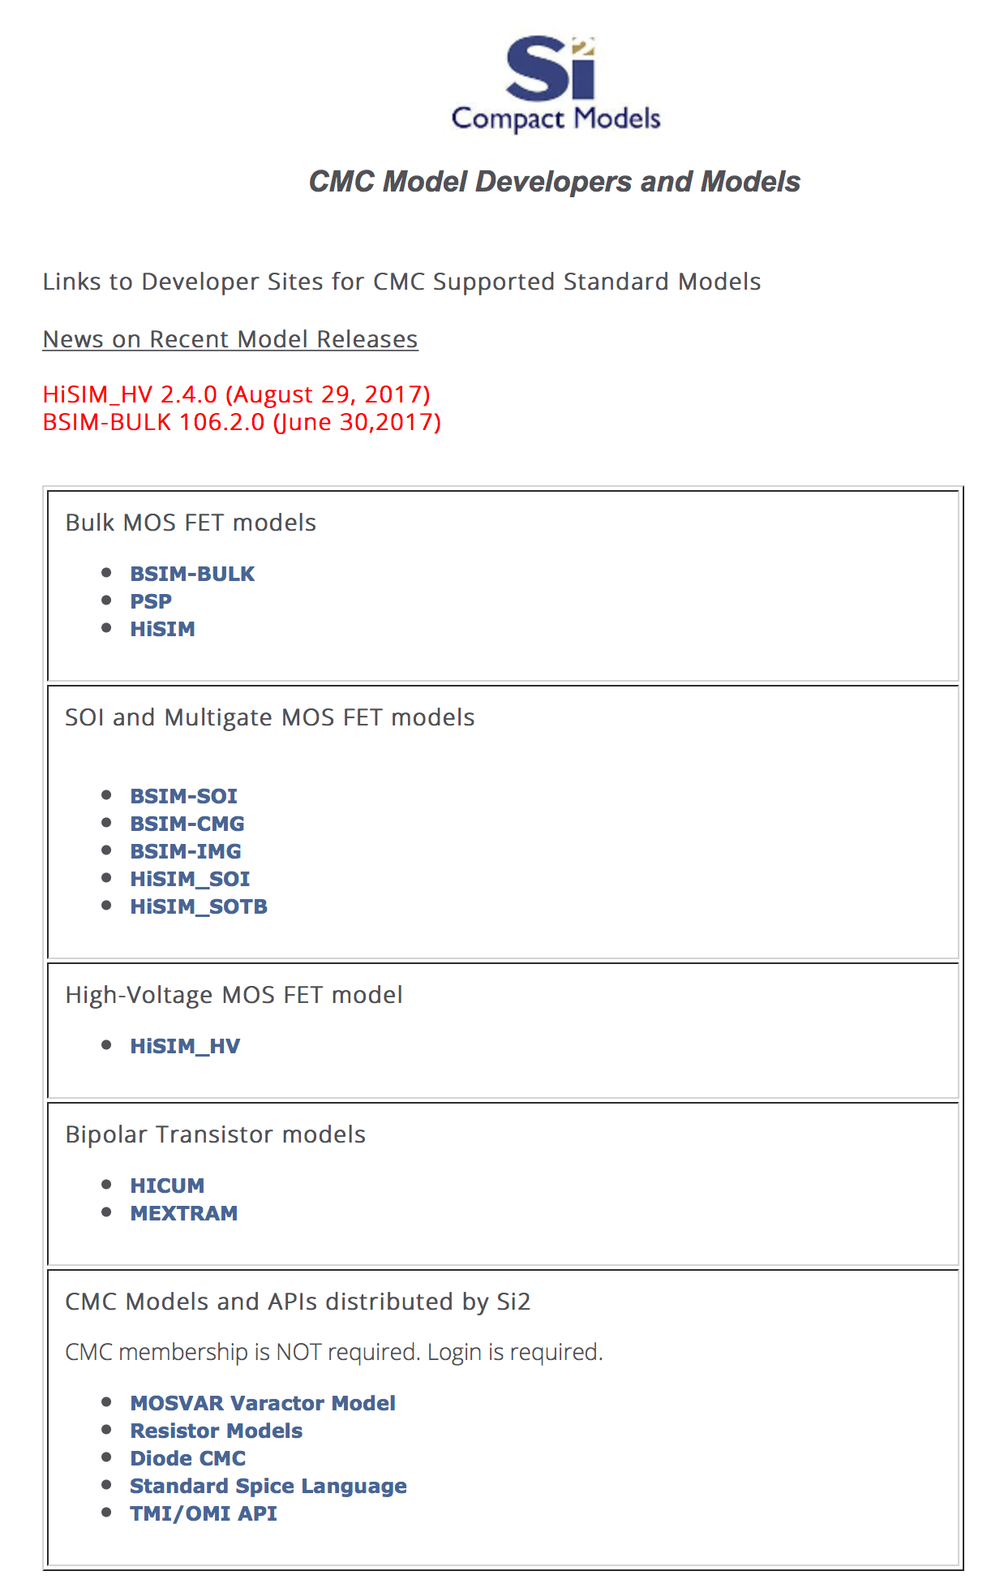
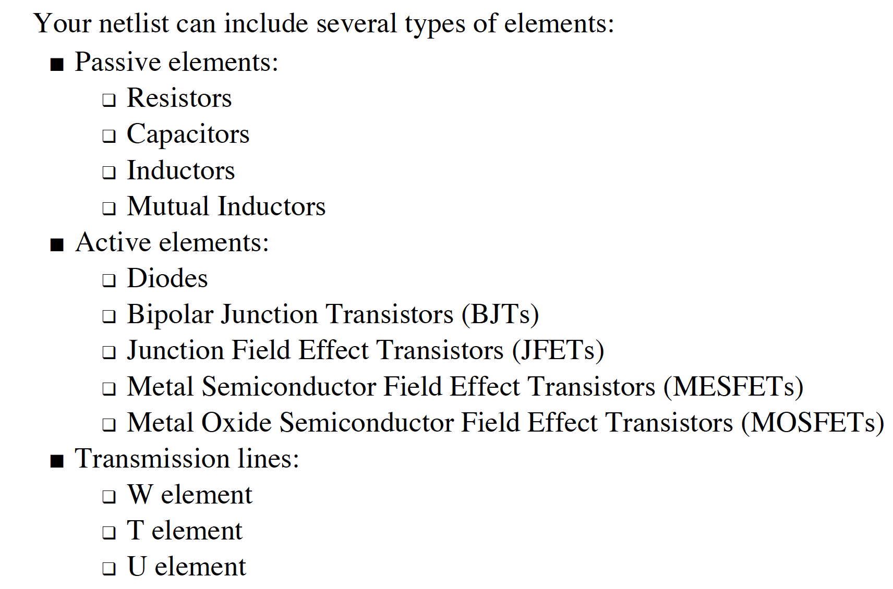
No standard memory model in SPICE yet
No standard models in Commercial SPICE or plans from the Compact Model Coalitions
No agreed framework for memory modeling

Slide 7



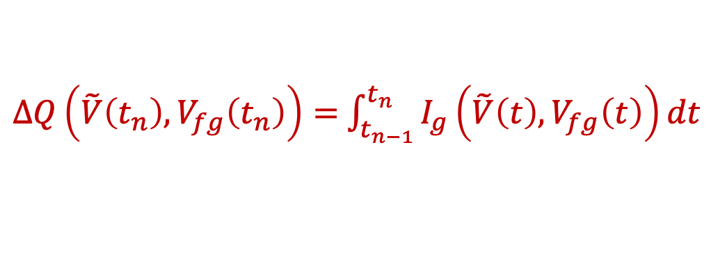


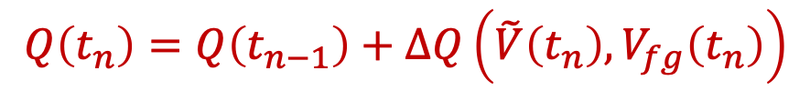
Example: FLASH memory simulation
Indirect method: using the numerical solution in SPICE
$$Q\left(t_{n}\right)=Q\left(t_{n−1}\right)+ΔQ\left(\tilde{V}\left(t_{n}\right),V_{fg}\left(t_{n}\right)\right)$$
$$V_{fg}\left(t_{n}\right)=f_{fg}\left(Q\left(t_{n}\right)\right)$$
$ΔQ\left(\tilde{V}\left(t_{n}\right),V_{fg}\left(t_{n}\right)\right)=$ $\int_{t_{n−1}}^{t_{n}}{I_{g}\left(\tilde{V}\left(t\right),V_{fg}\left(t\right)\right)dt}$
$$Q\left(t_{n}\right)$$
$$V_{fg}\left(t_{n}\right)=f_{fg}\left(Q\left(t_{n}\right)\right)$$
n+
n+
$$I_{D}=f\left(\tilde{V}\left(t_{n}\right),V_{fg}\left(t_{n}\right)\right)$$
$$I_{g}\left(\tilde{V}\left(t\right),V_{fg}\left(t\right)\right)$$
Equivalent to adding an internal node to keep track of the state variable V_{fg}(t) and Q(t)
Leading to slower simulation

Slide 8

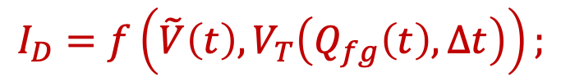

Dynamic System Simulation Methodology
Need an internal state variable to keep track on the state of the device for each instance
instant parameters
X1 1 0 L=1u W=1u Qg=10p Vt=0.7
…
.MODEL XMEM (VTO=-0.8V KP=16U
… )
model parameters
SPICE input deck
Some instant parameters are used as state variables to calculate the current change
$$I_{D}=f\left(\tilde{V}\left(t\right),V_{T}\left(Q_{fg}\left(t\right),Δt\right)\right);$$
$$V_{T}\left(Q_{fg}\left(t\right),Δt\right);$$
$$Q_{fg}\left(\tilde{V}\left(t\right),Δt\right)$$
More accurate with more internal states without speed penalty

Slide 9



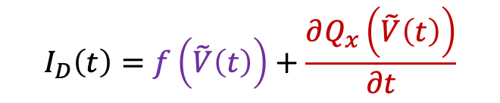


Example: FLASH memory simulation
Direct method
Indirect method
$$V_{T}\left(t_{n}\right)=f\left(Q\left(t_{n}\right)\right)$$
$$\tilde{V}\left(t\right)→\left[\tilde{V}\left(t\right),V_{fb}\left(t\right)\right]$$
$$I_{D}\left(t\right)=f\left(\tilde{V}\left(t\right)\right)+\frac{∂Q_{x}\left(\tilde{V}\left(t\right)\right)}{∂t}$$
$$Q\left(t_{n}\right)$$
$$Q\left(t\right)$$
n+
n+
$$I_{g}\left(\tilde{V}\left(t\right)\right)$$
Direct method
Change in internal parameter is more explicitly expressed
Constant bias
Accumulated charge
Change in V_{T}
Change in Current
V
V_{T}(t)
I_{D}(t)
Q(t)
t
t
t
t

Slide 10
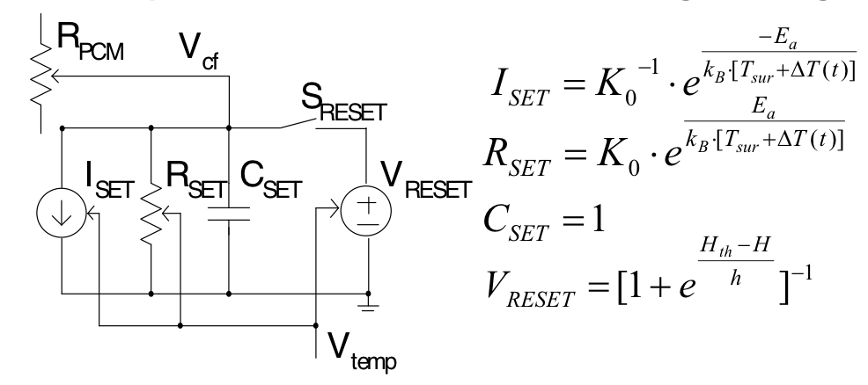
Example: phase change memory
The state variable is not an electrical but a physical quantity referred to as a crystal fraction
Need to express the state variable into a time dependent linear differential equation to implement it into a subcircuit
Or the crystal fraction can be treated as an internal parameter that change with time
The Johnson-Mehl-Avrami (JMA) equation
Subcircuit (K. C. Wong et. al. EDSSC 2009)

Slide 11
Defining Initial States
How to define at the initial values of the internal state variables such as crystal fraction?
Users maybe asked to enter the values
  How to extract these parameters from observable measurement results?
Let users input some physically measureable quantity like resistance and the state variables are internally extracted?
  No guarantee it can be achieved
Assume all cells start from one of the states
  A pre-program run is necessary to define the internal state of the cells

Slide 12
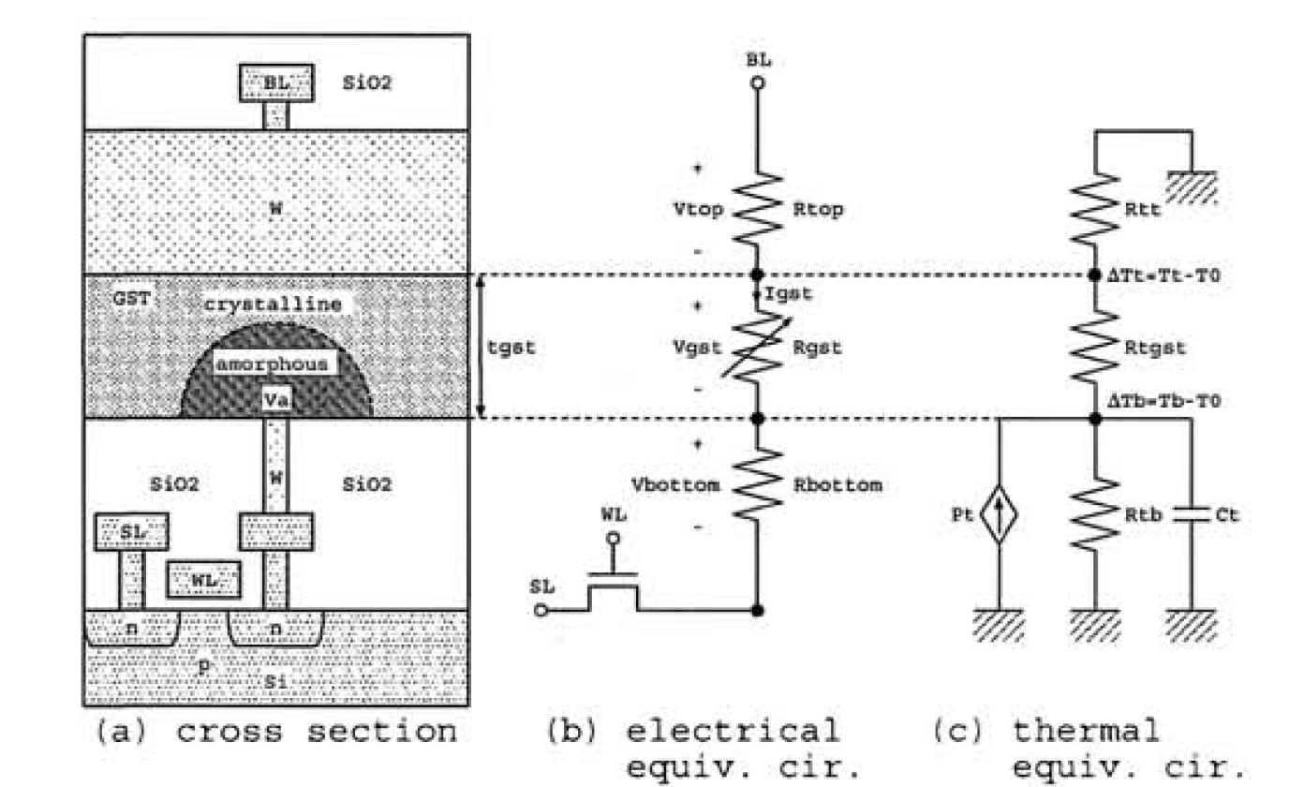
Generic approach to remove internal nodes
Many memory models are based on macro-model approach with many internal nodes
K. Sonoda, Renesas Technology
Example, the temperature model for a PCM cell
The temperature can be represented by an internal parameter
More commonly, it is represented by a voltage obtained from a subcircuit

Slide 13
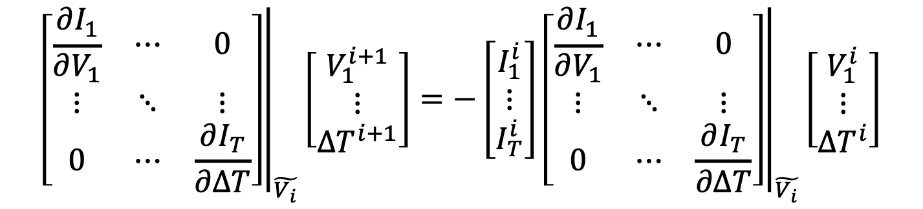
Effects of internal nodes
Jacobian Matrix in SPICE
$${\left.\left[\begin{matrix}\frac{∂I_{1}}{∂V_{1}} & ⋯ & 0 \\ ⋮ & ⋱ & ⋮ \\ 0 & ⋯ & \frac{∂I_{T}}{∂ΔT}\end{matrix}\right]\right|}_{\tilde{V_{i}}}\left[\begin{matrix}V_{1}^{i+1} \\ ⋮ \\ {ΔT}^{i+1}\end{matrix}\right]=−\left[\begin{matrix}I_{1}^{i} \\ ⋮ \\ I_{T}^{i}\end{matrix}\right]{\left.\left[\begin{matrix}\frac{∂I_{1}}{∂V_{1}} & ⋯ & 0 \\ ⋮ & ⋱ & ⋮ \\ 0 & ⋯ & \frac{∂I_{T}}{∂ΔT}\end{matrix}\right]\right|}_{\tilde{V_{i}}}\left[\begin{matrix}V_{1}^{i} \\ ⋮ \\ {ΔT}^{i}\end{matrix}\right]$$
Each internal node creates one entry in the matrix
As these nodes are isolated from other nodes, they directly increase the size of the Jacobian matrix

Slide 14
Example: a n-stage ring oscillator
With out internal nodes, the size of the Jacobian matrix ~ (n+2)²
With one additional internal node for each transistor, the size of the Jacobian matrix increased to ~ (3n+2)²
Simulation time increase with the size of the Jacobian matrix in the order of O(n^{1.4}) which is about 4.7 times

Slide 15
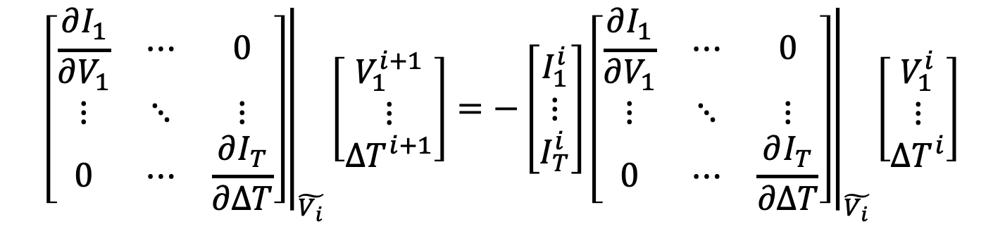
Eliminating internal nodes
Jacobian Matrix in SPICE
$${\left.\left[\begin{matrix}\frac{∂I_{1}}{∂V_{1}} & ⋯ & 0 \\ ⋮ & ⋱ & ⋮ \\ 0 & ⋯ & \frac{∂I_{T}}{∂ΔT}\end{matrix}\right]\right|}_{\tilde{V_{i}}}\left[\begin{matrix}V_{1}^{i+1} \\ ⋮ \\ {ΔT}^{i+1}\end{matrix}\right]=−\left[\begin{matrix}I_{1}^{i} \\ ⋮ \\ I_{T}^{i}\end{matrix}\right]{\left.\left[\begin{matrix}\frac{∂I_{1}}{∂V_{1}} & ⋯ & 0 \\ ⋮ & ⋱ & ⋮ \\ 0 & ⋯ & \frac{∂I_{T}}{∂ΔT}\end{matrix}\right]\right|}_{\tilde{V_{i}}}\left[\begin{matrix}V_{1}^{i} \\ ⋮ \\ {ΔT}^{i}\end{matrix}\right]$$
As the node is loosely coupled, it can be directly evaluated without putting into the Jacobian matrix

Slide 16
Eliminating internal nodes
Jacobian Matrix in SPICE
$${\left.\left[\begin{matrix}\frac{∂I_{1}}{∂V_{1}} & ⋯ & 0 \\ ⋮ & ⋱ & ⋮ \\ 0 & ⋯ & \frac{∂I_{T}}{∂ΔT}\end{matrix}\right]\right|}_{\tilde{V_{i}}}\left[\begin{matrix}V_{1}^{i+1} \\ ⋮ \\ {ΔT}^{i+1}\end{matrix}\right]=−\left[\begin{matrix}I_{1}^{i} \\ ⋮ \\ I_{T}^{i}\end{matrix}\right]{\left.\left[\begin{matrix}\frac{∂I_{1}}{∂V_{1}} & ⋯ & 0 \\ ⋮ & ⋱ & ⋮ \\ 0 & ⋯ & \frac{∂I_{T}}{∂ΔT}\end{matrix}\right]\right|}_{\tilde{V_{i}}}\left[\begin{matrix}V_{1}^{i} \\ ⋮ \\ {ΔT}^{i}\end{matrix}\right]$$
As the node is loosely coupled, it can be directly evaluated without putting into the Jacobian matrix

Slide 17
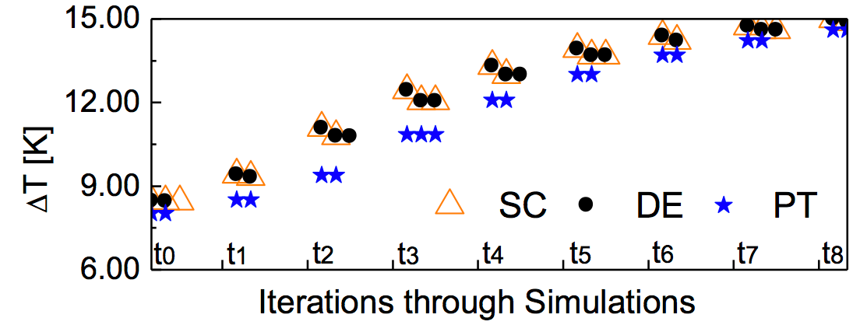
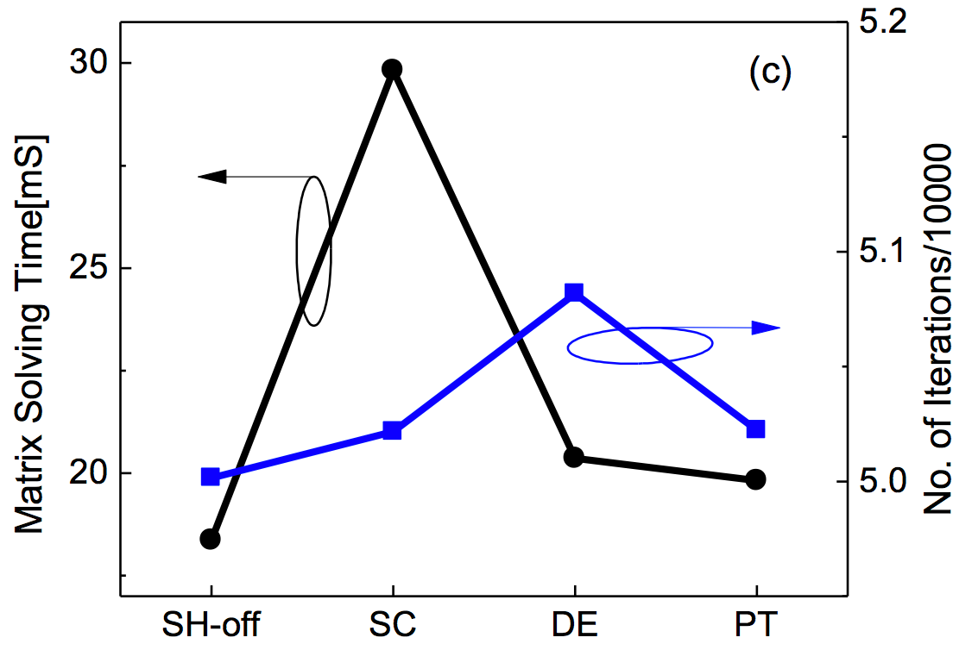
Simulation flow
The internal node can be eliminated without making any differences
Lining Zhang et. al., JEDS Jan. 2018

Slide 18
Non-quasi-effects in MOSFETs
The approach is generic and can be used in any isolated internal nodes
Using the direction evaluation for NQS effect in BSIM

Slide 19
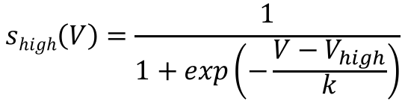
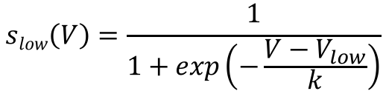
Convergence issues
K. C. Wong et. al. EDSSC 2009
Some model contain switches causing convergence problem
a generic smoothing hysteresis function can be used
$$S\left(V\right)=S\left(V\right)slow\left(V\right)+\left(1−S\left(V\right)\right)shigh\left(V\right)$$
$$slow\left(V\right)=\frac{1}{1+exp\left(−\frac{V−V_{low}}{k}\right)}$$
$$shigh\left(V\right)=\frac{1}{1+exp\left(−\frac{V−V_{high}}{k}\right)}$$
S(V)
S is a hysteresis function between 0-1 with V_{low} and V_{high} as the two triggering point
V
V_{low}
V_{high}

Slide 20
Simulation Example
Simulation of a PCM cell array without speed and convergence problems
read high
set
read low
reset
read high

Slide 21

Another type of dynamic system: Device degradation
With a constant bias, the device characteristics still drift with time with rate depends on bias condition
V_{D}
V_{T}
bias2
I_{D}
bias1
V_{G}
bias1
bias2
t
t
Usually modelled as change of some parameters over time
For example: NBTI hole trapping model (P. M. Lenahan, TDMR 11(2), 2011)
Currently, neither modeled by internal parameter or internal node

Slide 22
Extracting degradation characteristics
Normally, a constant bias is applied because actual waveform is during operation is unknown
V_{D}
V_{T}
bias2
I_{D}
fresh
age2
flesh
bias1
age1
@ age1
V_{G}
age1
bias1
age2
flesh
bias2
t
t
@ age-n
age1
age2
age1
age2
A parameter is used to keep track of the “age” of the device
The time required to reach different age at different bias condition is recorded
A set of parameters extract at different age at a constant bias is used for the aged simulation

Slide 23
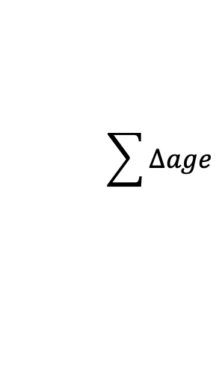
Aging simulation
Input Deck
SPICE Circuit Simulation
Output
Loop
fresh model parameter file
aged model parameter file
Post-processor and projection
fresh
age 1
age 2
age-n
A post-processor is needed to convert the wave form at individual terminal to accumulated degradation
Data points from table
V_{n}
V_{n}
V_{T}
V_{Taged}
$$\sum{Δage}$$
t
t
t
t_{sim}
Δage₁
Δage₂

Slide 24
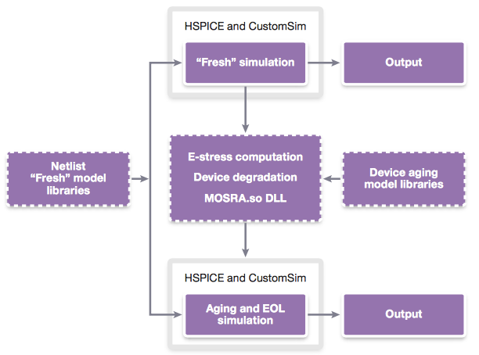
Industrial application example
It is done by MOSRA in Synopsys or RelXpert in Cadence
Using short term simulation with fresh device data to project long term degradation
No continuous evolution
V_{n}
t
t_{sim}
t_{aged}
https://pdfs.semanticscholar.org/3f78/524f5c3e6d7da1b2f4c322031ad1f415da80.pdf

Slide 25
Single step aging simulation with dynamic parameters
at any age in the life of the circuit
Input Deck
SPICE
Time accumulation recorded by age
Time dependent parameters V_{T}(age), μ(age) from reliability models
Output
fresh model parameter file
The reliability simulation loop is combined with the SPICE circuit simulation loop
More powerful, but faster and simpler simulation flow
Reliability model work closer to the device physics (e.g. impact of self-heating on NBTI become possible)
Drawback: reliability model have to be developed together with the core model instead of a universal add-on

Slide 26
Including parameter update in aging simulation
versus
Including hot carrier V_{th} degradation model
The final current is used to project the parameter degradation

Slide 27
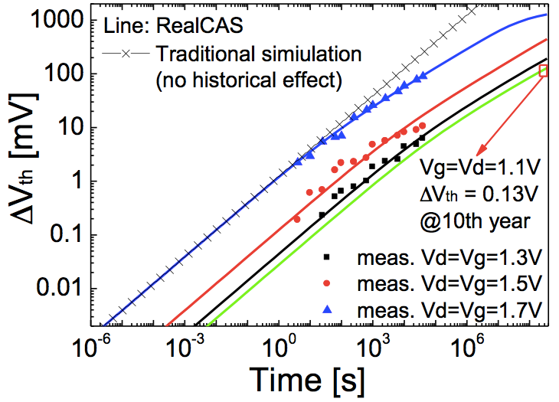
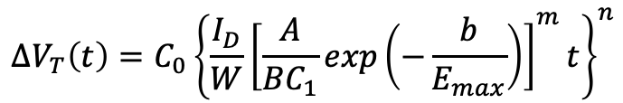
Fitting degradation data
Degradation rate deviates from the general power-law time-function prediction
Static data extraction cannot handle dynamic behavior
$$∆V_{T}\left(t\right)=C_{0}{\left\{\frac{I_{D}}{W}{\left[\frac{A}{BC_{1}}exp\left(−\frac{b}{E_{max}}\right)\right]}^{m}t\right\}}^{n}$$
V_{in}
NBTI
Using dynamic parameter update does not require to change the underlying physics under static bias
t

Slide 28
Runtime example
Time evolution of current degradation
Aging description
flesh
degraded
Parameter update
In addition to the result, the degradation process can be simulated

Slide 29
From static data to switching behavior
Device level aging parameters are extracted based on static biasing data
How to accumulate “age” from different characteristics when varying inputs are used?
V_{bias}
ΔV_{T}
V₃
V_{bias}
V₃
?
V₂
V₂
V₁
V₁
t
t
t

Slide 30
Calculating age accumulation
What about switching to different curve at the time when input voltage is changed?
V_{bias}
ΔV_{T}
V₃
ΔV_{T}
V₃
?
?
V₂
V₂
V₁
V₁
t
t
t
Need to find out the current state with respect to the new characteristics before switching
V_{bias}
ΔV_{T}
V₃
V₃
V₂
V₂
V₁
V₁
t
t

Slide 31
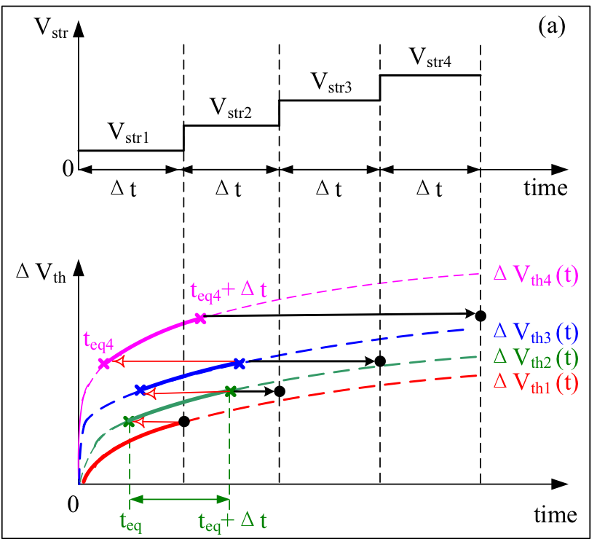
Dynamic age accumulation
A equivalent time point t_{eq} is used to start the aging condition
Steps:
  Start with t_{eq1}=0 for degradation under V_{str1} ending at Δt to calculate ΔV_{th}(Δt)
  calculate equivalent start time (t_{eq2}) of based on ΔV_{th}(Δt) and characteristics of ΔV_{th2}
  second period start at t_{eq2} to (t_{eq2}+Δt) at which ΔV_{th2}(t_{eq2}+Δt) is calculated and used to calculate the t_{eq} for next period

Slide 32
Dynamic voltage step
It is possible that at some high biasing point, the device has aged enough that no more aging occurs when switched to a lower voltage
The dynamic age accumulation algorithm keeps the present age without further degradation

Slide 33
NBTI example
The dynamic aging accumulation approach is able to handle NBTI degradation with random switching
Data from J. Velamala, et al., IRPS 2013, p. CM.3.1.

Slide 34
Performing long term aging simulation
How to simulate aging over long period of time, say 10 years?
Time Tracing method:
  physically extend the time axis to over 10 years
  Most accurate but very time consuming
Direct projection:
  Using a very short period of simulation and directly project results on the other end of the time axis based on certain projection function
  Need to assume same short-term and long-term mechanisms
  Fast but only very crude projection

Slide 35
Current approach
ΔV_{T}
Using a short period of simulation and directly project to the required lifetime
Further degradation in intermediate time is ignored
If short-term and intermediate term degradation mechanism is different, the projection may be incorrect
1s
projection
(10 year)
1s
t
fresh
aged
total time in simulation
t
1s
2s

Slide 36
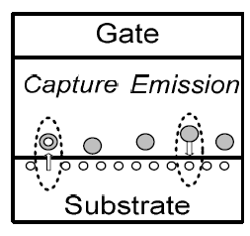
Degradation mechanism example
Interface state generation dominate in short term and hole-trapping dominate in intermediate term
Interface state generation
hole-trapping model
J. B. Velamala, IRPS, p. CM.3.1, 2013
P. M. Lenahan, TDMR 11(2) p. 219, 2011

Slide 37
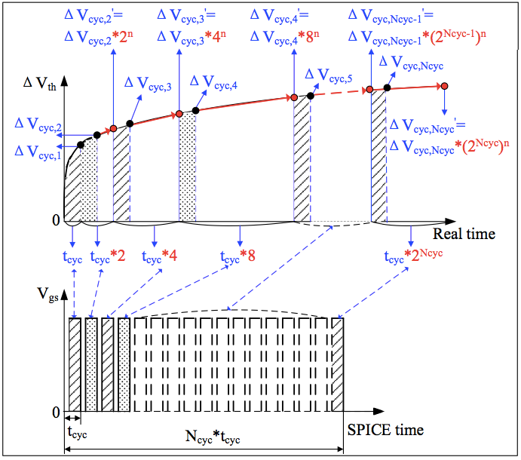
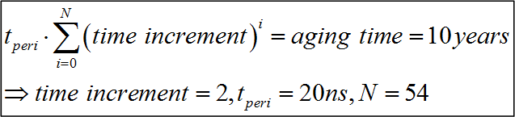
Adaptive projection method
Divide the aging period into N_{cyc} uneven cycles
For the i^{th} cycle, it is further divided into of a time tracing period of t_{cyc} and a project period of t_{cyc}*2^{i}
Example
10 year simulation time is mapped to 1.08μsec

Slide 38
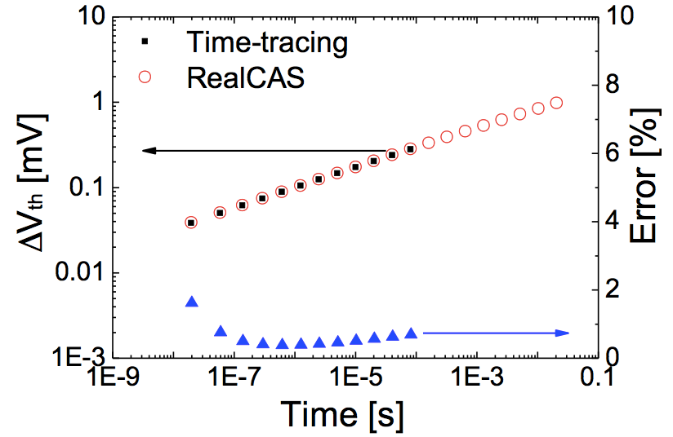
Example: device characteristics
It takes about two hours to perform the simulation with time tracing and only 10s with the adaptive projection method with minimal error

Slide 39
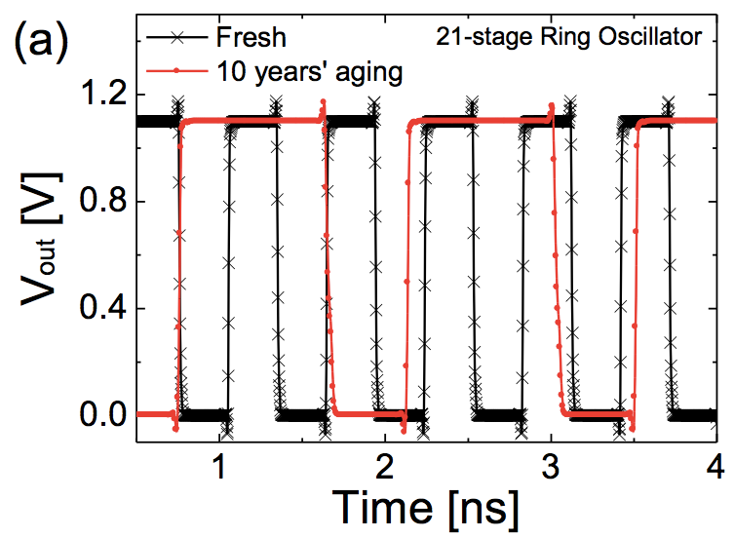
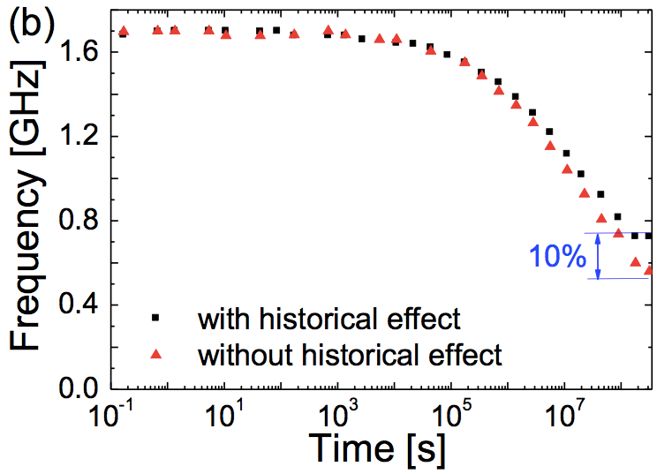
Example: ring oscillator
The module has been implemented into a circuit simulator and it ready for trial

Slide 40
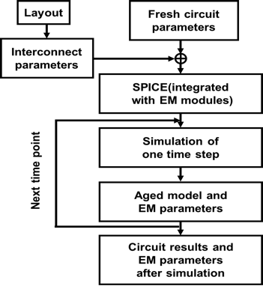
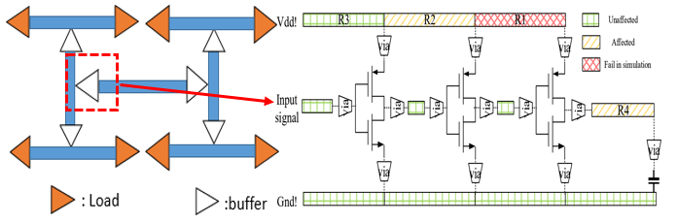
Other applications
Circuit failure due to electromigration
Use layout extractor to extract the wire resistance
Dynamic parameter change included in the extracted resistance
More holistic simulation tracking the time evolution of the entire circuit instead of just a ”pass/fail” qualification process

Slide 41
Summary
Compact models are mainly developed for static systems
Dynamic instant parameters play a more important role in dynamic system to record the status of a device
Internal nodes should be eliminated to improve simulation speed and a generic approach has been developed for such purpose
A more systematic approach is needed to model memory devices for neuromorphic computing
A more holistic reliability simulation approach is demonstrated
A few questions remains, for example, how to perform parameter extraction for a dynamic system?

Slide 42
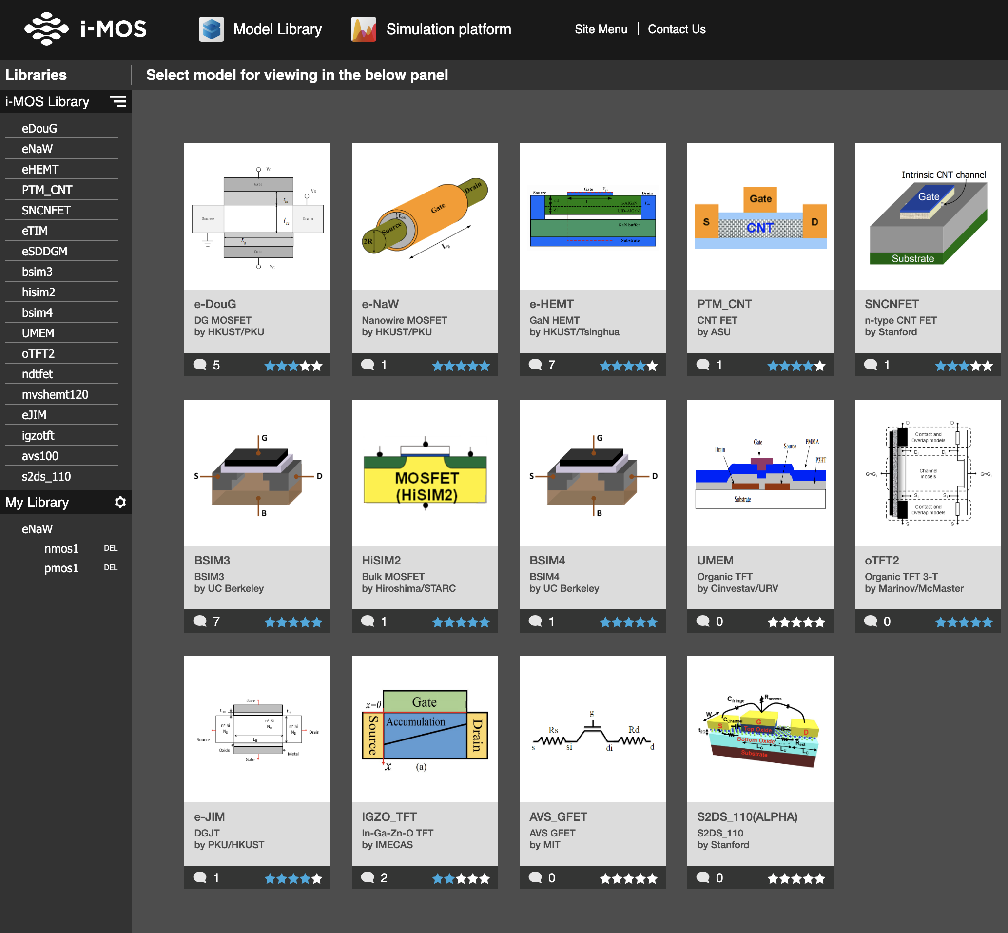

More resources
http://i-mos.org/

Slide 43


An advertizement
An animation based semiconductor class:
Part I: PN Junction and BJT
https://www.edx.org/course/principle-of-semiconductor-devices-part-i-semiconductors-pn-junctions-and-bipolar-junction-transistors-1
Part II: FETs and MOSFETs
https://www.edx.org/course/principle-of-semiconductor-devices-part-ii-field-effect-transistors-and-mosfets

